Slide 1
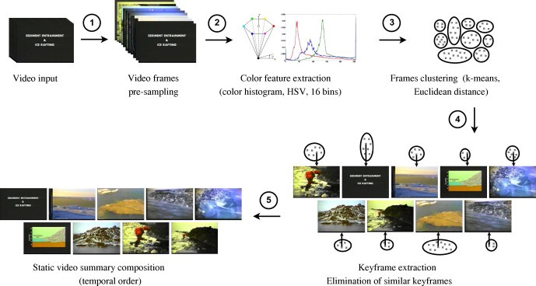
Project
Video summarization
Team Members : Priya Sharma Pranjul Itondia Prakanshu Sahu

Slide 2
Video Summarization
“Video summarization is the process of distilling a raw video into a more compact form without losing much information.”

Slide 3
Applications-
AI is playing a key role with video summarization, a process of shortening a video by selecting keyframes or parts of videos that captures the main points in the video.
Summarization has many use cases, with one of the most significant being the ability to gauge interest in content.
Flashcard summary can determine how many people will actually watch an entire video.
Video summarization is also necessary for efficient viewing of the material and for video length adaptation for different mediums, like Instagram, Facebook,etc.

Slide 4
Some Real Life Applications-
CCTV (Closed-circuit television) cameras are installed and surveillance videos are being recorded round the clock in security critical places resulting in a massive quantity of video data being generated endlessly.so by summarizing them we can get all the relevant information in compact form.
News, Movies, Sports and Internet Videos- Summarizing news videos automatically allows us to quickly look out for the important patterns shown in the news. Generating a trailer of a movie and highlights of sports video recordings automatically are some of the engrossing applications of video summarization.

Slide 5
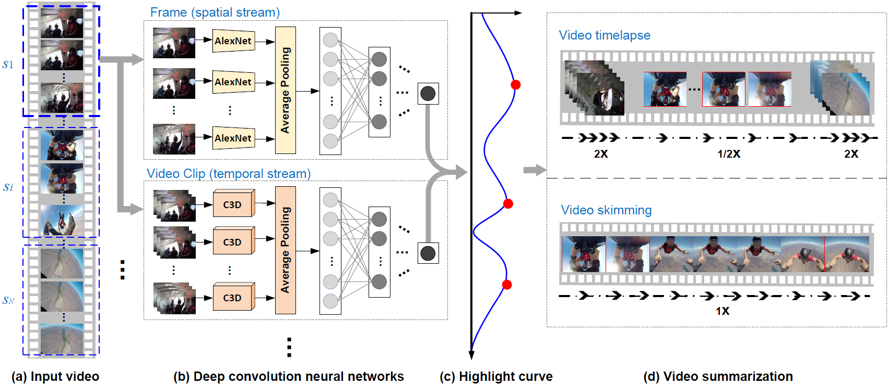

Slide 6
1 .Convolutional nueral networks 2 .LSTM for description generation 3 .Python for basic language 4 .HTML,CSS,FLASK for deployment 5 .Libraries such as keras,tensorflow,opencv,PIL,trax,opencv,nltk. 6 .Language models for video tagging 7 .PYSPARK for handling big data 8 .Apache spark
Technologies Used

Slide 7

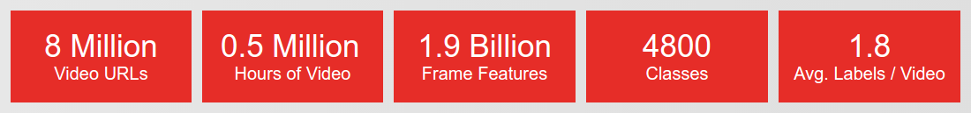
USEDDATASET :
:

Slide 8
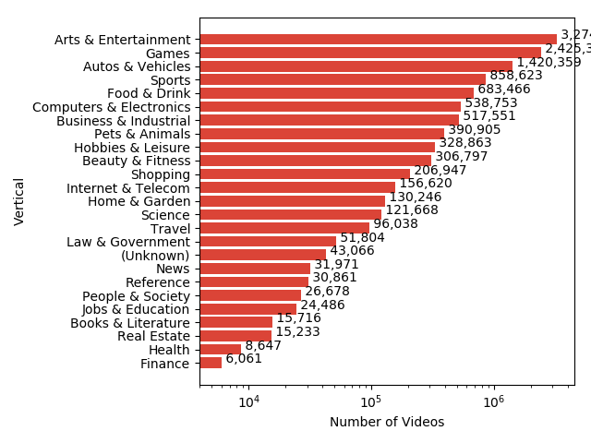

Slide 9
THANK YOU

